Slide 1




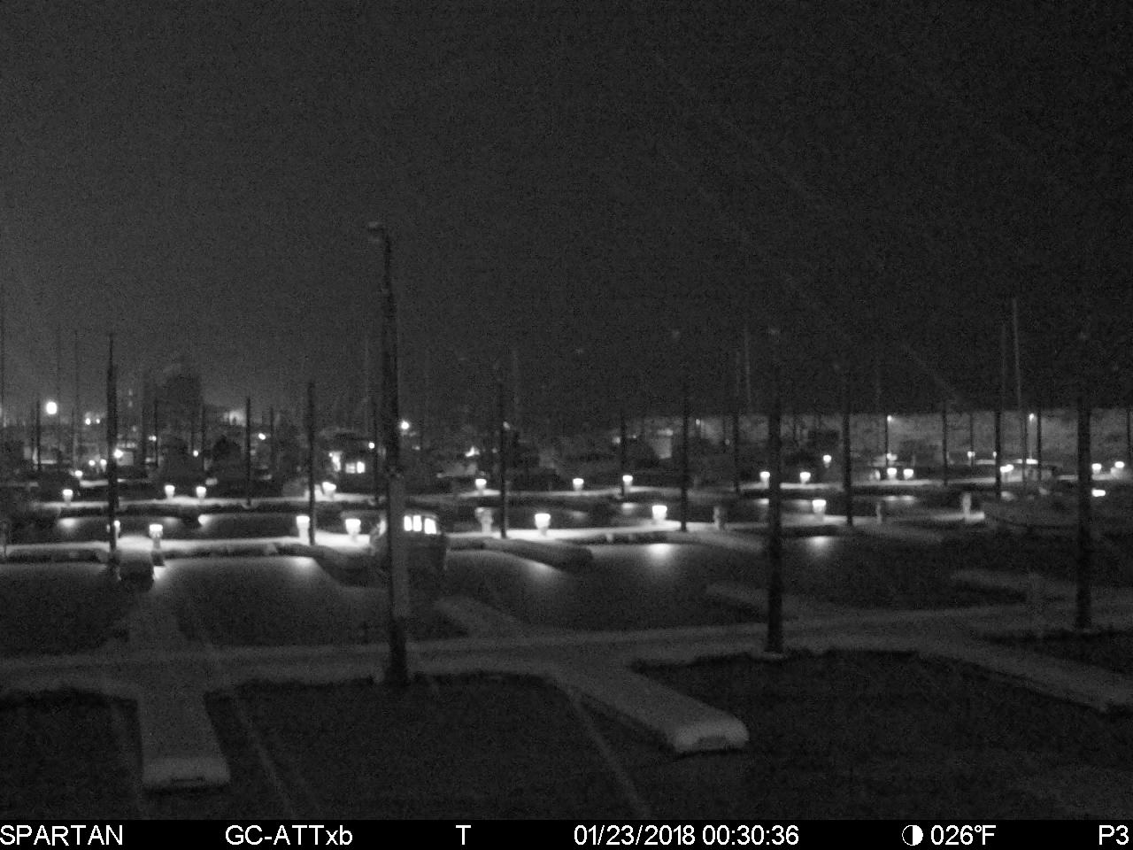
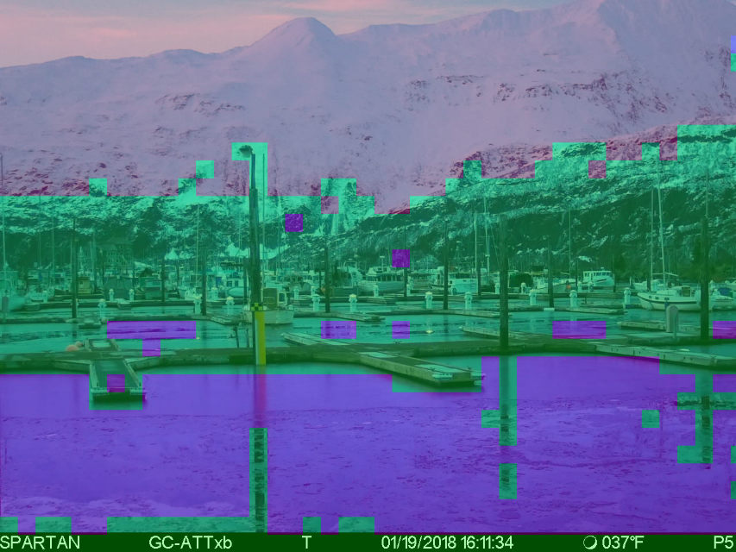
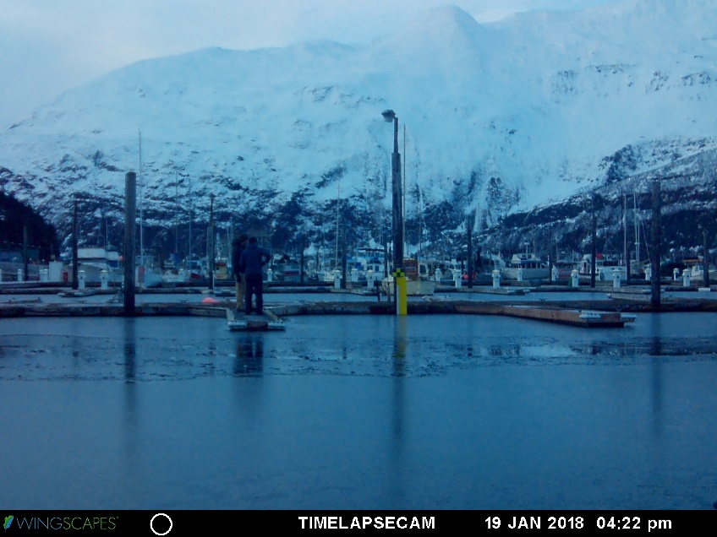
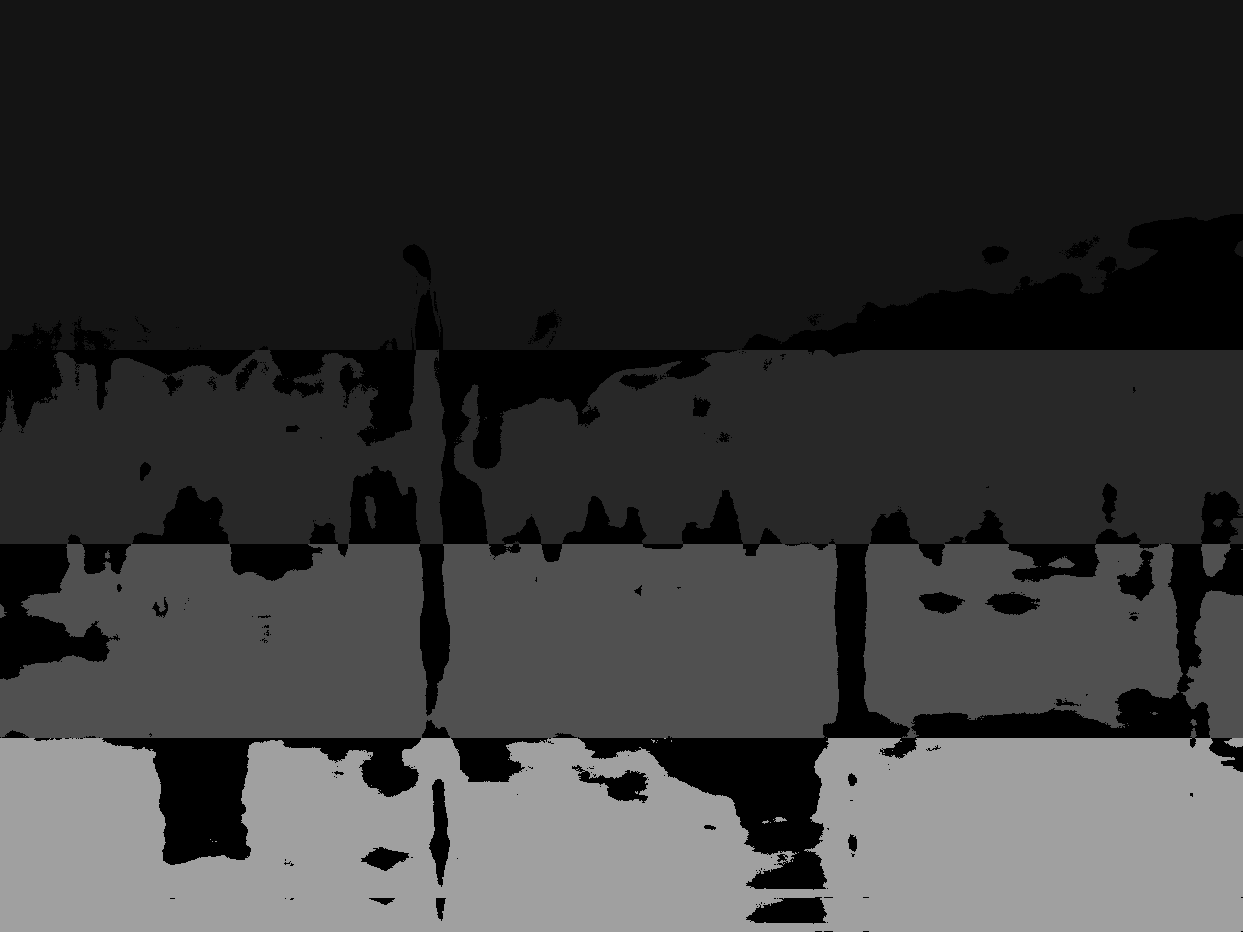
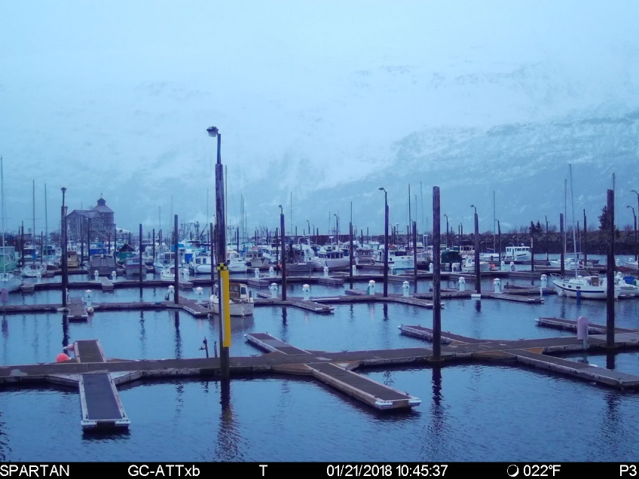
Water detection in an image using HOG and Neural Networks
Timothy Harrelson
tgharrelson@alaska.edu
Jeremy Swartwood
jswartwo@alaska.edu
Overview
Our project is to make software capable of determining where water lies in an image. These locations will then be used to determine heights of water for rivers and other bodies of water. Current processes are expensive. The proposed method will be cheaper and easier to implement and maintain.
Our method for determining where water is, uses an automated approach with supervised validation of the results. We read in training images, process their data, and using machine learning to classify where water is in an image. The process breaks down into three phases: Pre-processing, Feature Extraction, and Classification. Pre-processing is modifying the input images to be able to extract meaningful data from them. Feature Extraction takes the preprocessed images and retrieves the pertinent data that identifies water vs. non-water. Classification uses a Neural Network algorithm that takes in the extracted features and determines what is water or not water in an image.
Pick ROI and Generate Gabor Filters
4
.
3
Generate Gabor Filters
.
1
Sample
.
Lower Pass Filter
2
(Using ROI)
.
Generate Mask
Region Of Interest
(
ROI
(
)
with
4
color regions
(
)
Average and Subtract
)
(
from each region
)
Load Image
Output Mask
Run Image through ANN
Save image of Water
Pixels
5
.
Learn Regions using Artificial Neural Network
(ANN)
(
Run Features through ANN to learn the regions)
Pre-processing
Feature Extraction
Classification
To perform unsupervised extraction of features, the source image must be first analyzed to determine section of an image that are most likely to be water.
All Images are blurred using a low pass temporal filter.
Used K-means to group similar colors together into bands used as labels.
3. The input image is split into smaller regions.
4. Each smaller region has features extracted using Gabor filters ^{[1]}
Regions that fall between 2 bands generated from the preprocessing are not used as data.
5. Train the Neural Network on the data.
6. Validate and test predictions from trained Neural Network.
1. Low Pass Temporal Filter
2. Bands from K-Means
3. Input Image
4. Gabor Filter Generation
6. Classified Image
Band # and Desc
Band # and Desc
1. Sky/Mountains
1. Sky/Mountains
2. Buildings
2. Buildings
3. Unstable Water
4. Stable Water
4. Stable Water
Conclusion
Sources
Originally we had poor results using a different feature vector called HOG^{[2]}. This produced poor and almost random looking results. Switching to the Gabor filter led to failure accurate results. We had a low rate of misidentifying non-water as water, however confusing artifacts of the image such as reflections on the water caused a higher rate of the converse prediction (misclassifying water as non-water).
Being able to detect water in an image initially looked to be a simpler problem than it was. Numerous issues arose depending on the environmental conditions. Examples of issues are lighting, wind, fog, season (snow), and obstructions (boats/people). More advanced technology might be required to handle these outliers.
^{[1]} Farshad Nourbakhsh, P.B.Pati and A.G.Ramakrishnan, “Text Localization and Extraction from Complex Gray Images,” Proc. Indian Conf. Vision, Graphics Image Processing, ICVGIP 2006, Dec. 13-16, 2006, pp. 776-785.
^{[2]} Dalal, N. and Triggs, B., “Histograms of Oriented Gradients for Human Detection,” IEEE Computer Society Conference on Computer Vision and Pattern Recognition, 2005, San Diego, CA, USA
^{[3]} Dr. Cenek. Expertise and direction.

